Slide 1
Resurrecting Craigslist: A comprehensive redesign to enhance user experience
This presentation serves to propose a thorough redesign of Craigslist to improve user experience and revitalize the platform.
Jonathan Abeje

Slide 2
Problem (User Persona)
Nowadays, people are using other platforms to purchase their items, and one reason is because of how craigslist presents their website. Several users have complained about it but craigslist hasn’t taken the necessary measures to improve their platform. This has led to more and more users switching to purchasing from their competitors even though the pricing wasn’t the deciding factor. My proposed solution was to redesign the craigslist website in order to attract new customers, retain existing customers and most importantly, bring back the customers that left because of this issue.

Slide 3
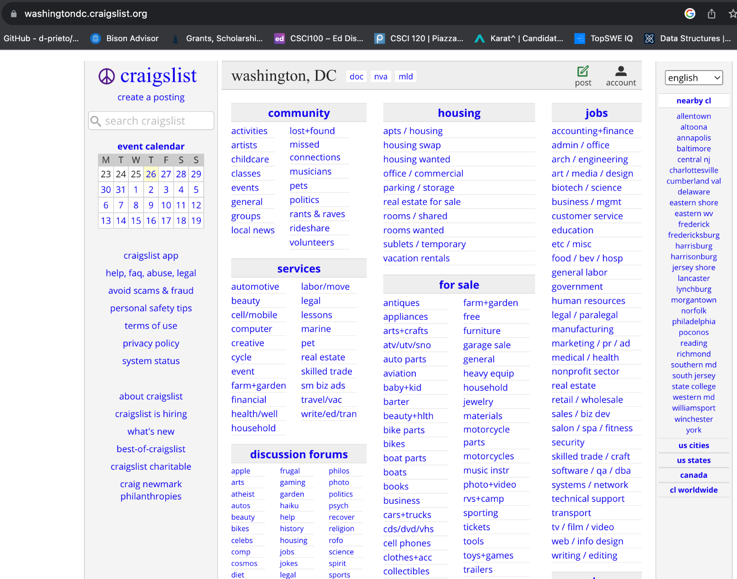
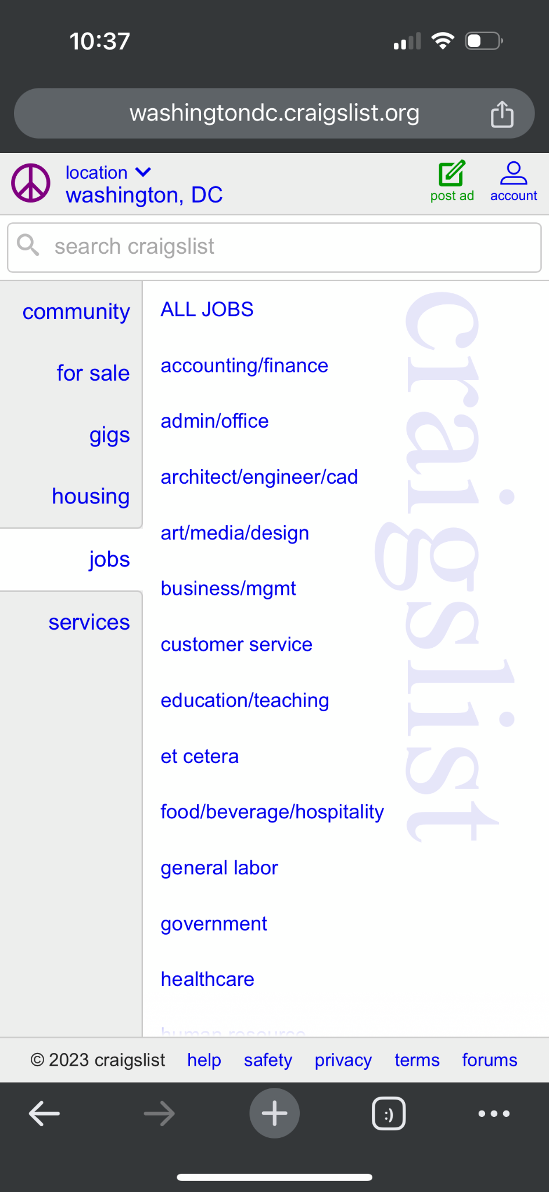
Current Website

Slide 4
How Might We Questions
Design Requirements
How might we make the website more engaging? eg. including pictures, welcoming/greeting messages, buttons instead of links?
How might we reduce the safety and scam concerns?
How might we improve the clustered spacing and unreadable fonts?
Functional Requirements
Ensure a functional hamburger menu to remove the clustering.
Including navigation buttons to go back and forth between pages instead of links.
Non-Functional Requirements
The user should be met with a more welcoming web page.
All text should be relevant, clear, and concise.

Slide 5
Ideation (Ideating Design Solutions)
The ideation method I chose was the Worst Possible Idea approach.
I was able to generate 6 bad ideas and narrowed them down to find these common themes:
Hindering the user's browsing capabilities because of the poor visuals of website layout.
Leaving the user frustrated because of the unrelated redirection of pages and random pop-ups.
This ideation approach gave me insight into my points of focus to make my craigslist redesign a success. This included improvements to the design features such as the layout as some components appear out of place, text is at times unreadable, some of the links should be buttons and the website itself looks very old and basic. If I made these features more appealing, it should ultimately result in an improved user experience.

Slide 6
Wireframe Progression
Storyboards: Google Drive Storyboard
Complete low fidelity version: Figma low fidelity wireframe - craigslist redesign
Complete high fidelity version: Figma high fidelity wireframe - craigslist redesign

Slide 7
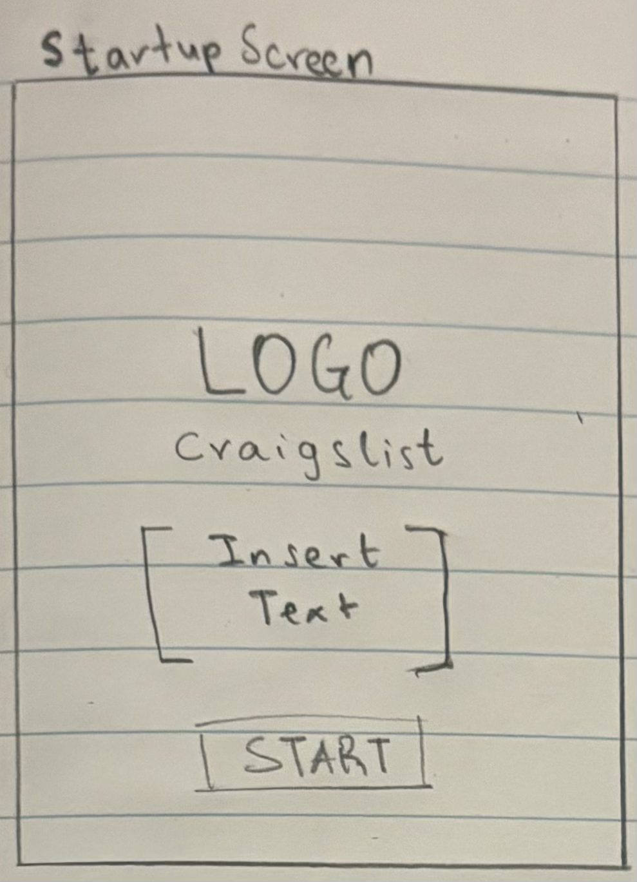
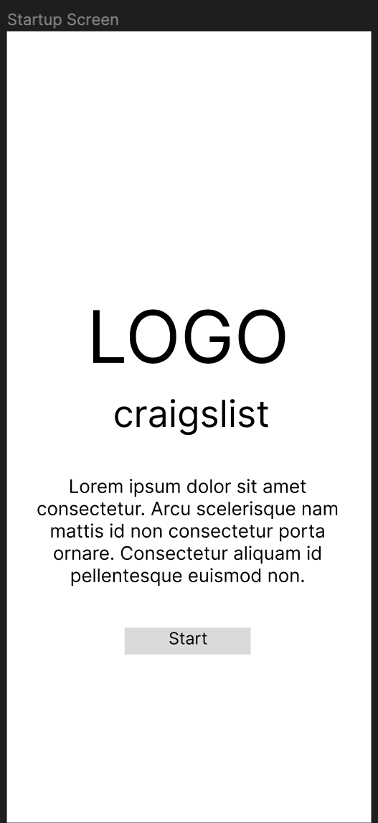
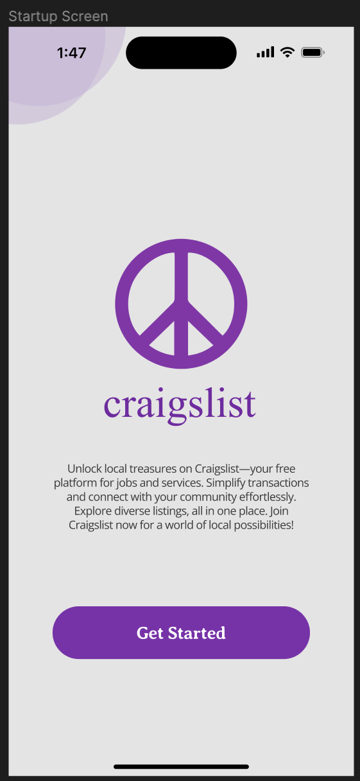

Slide 8
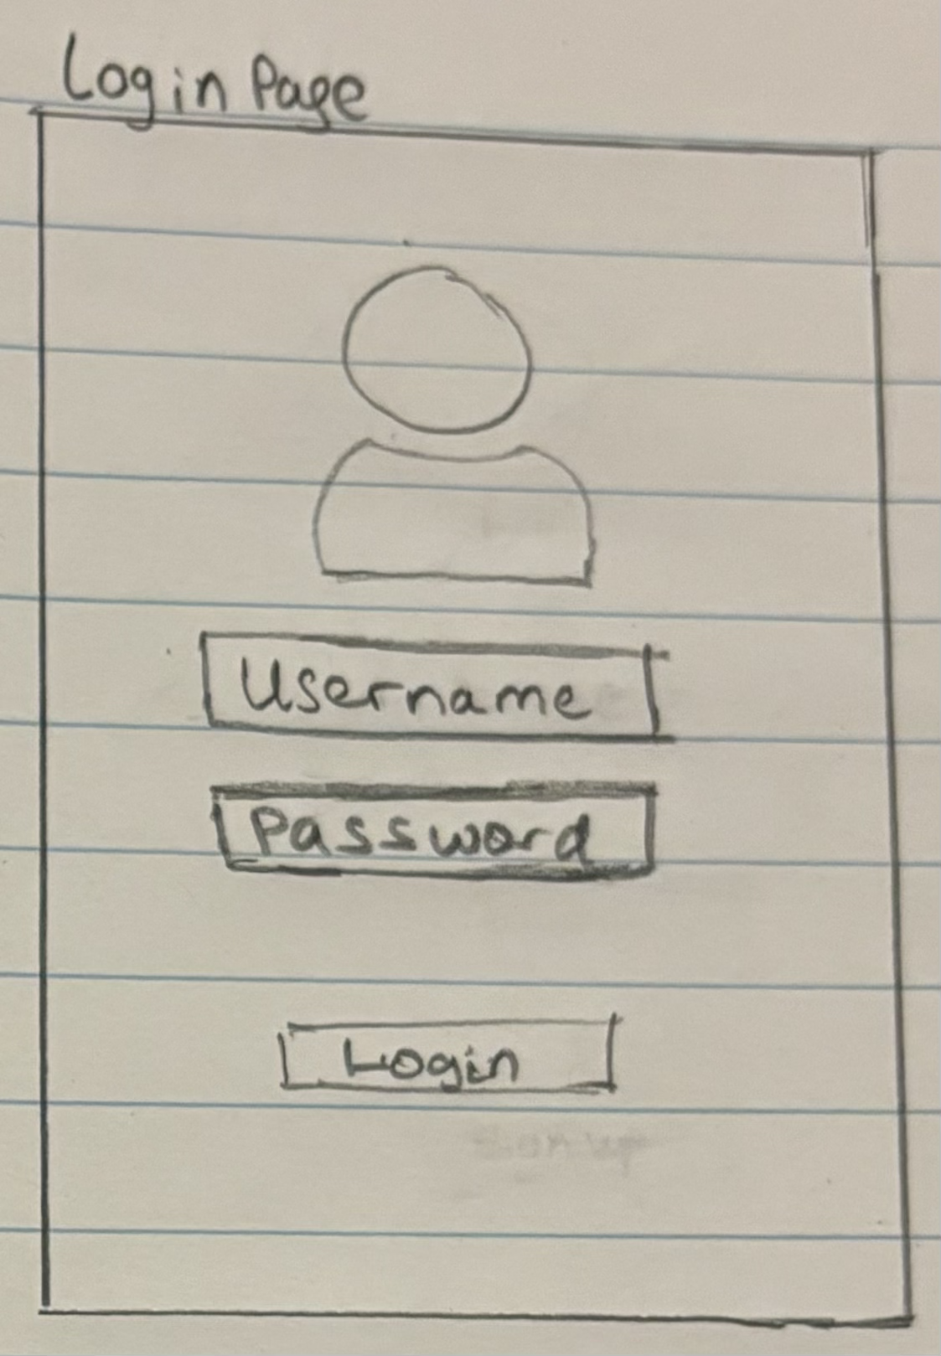
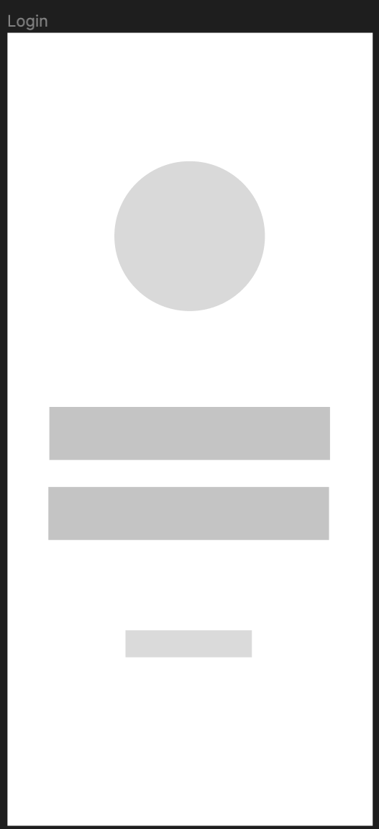
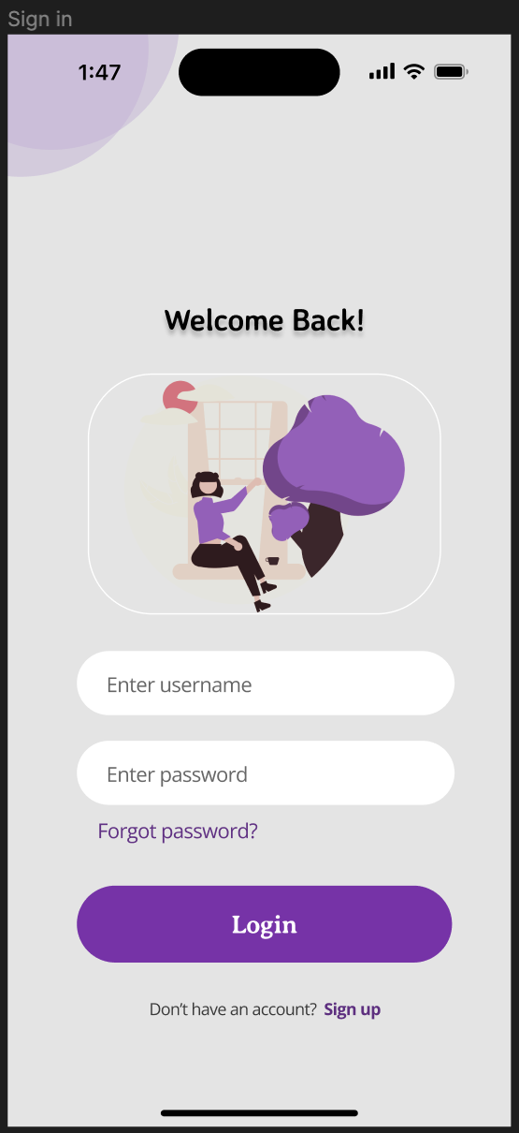

Slide 9
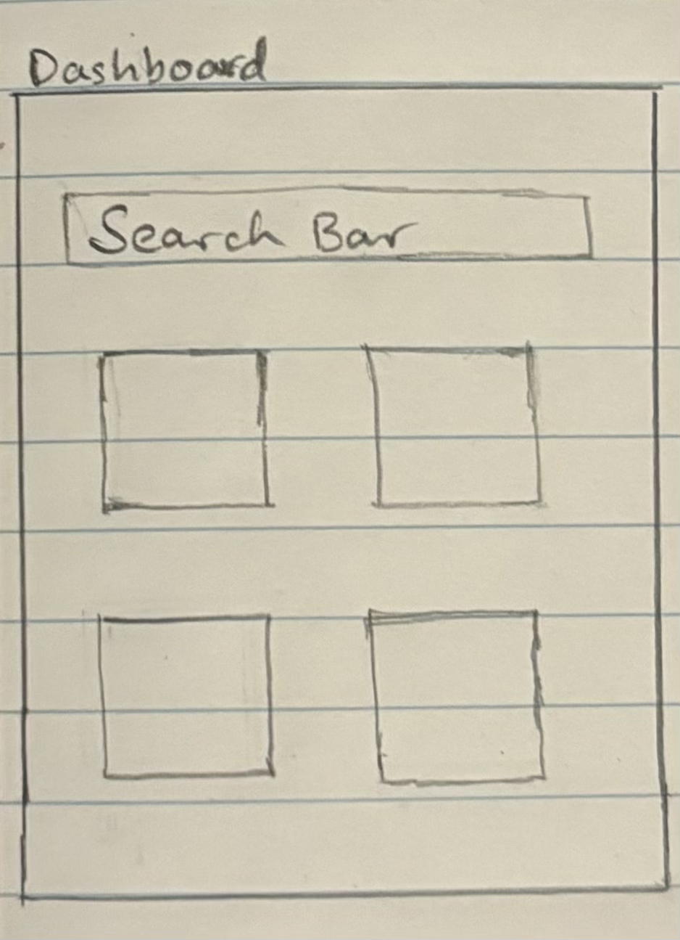
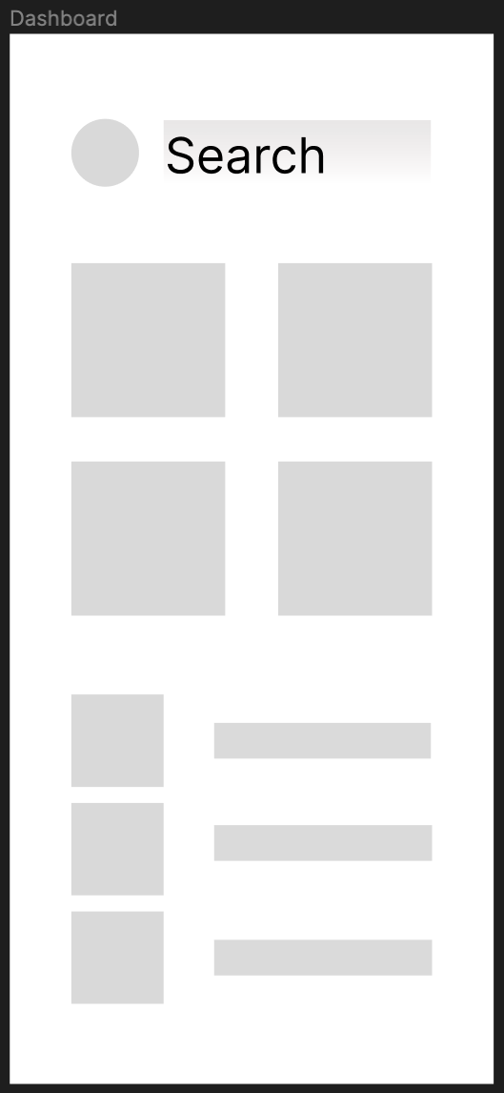
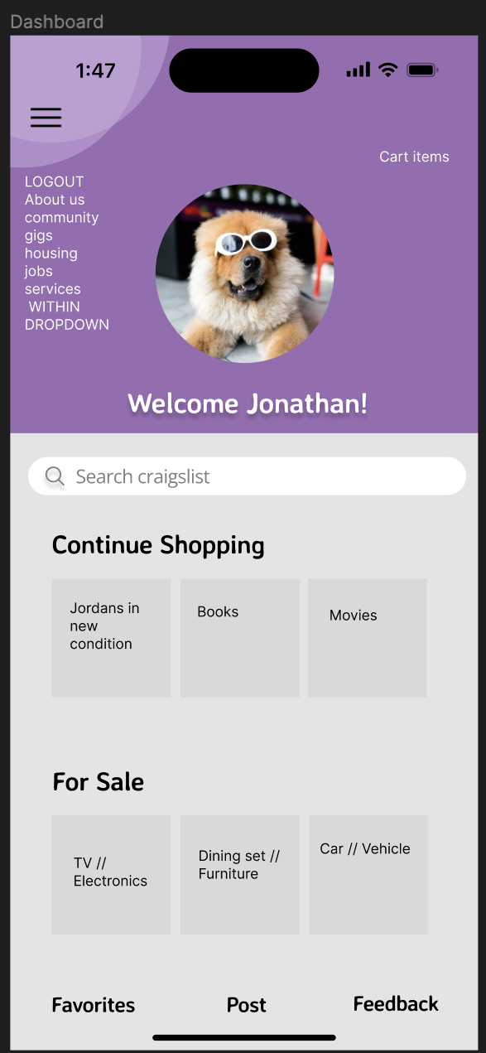

Slide 10
Interview (User Interview)
Micah is representative of my target audience because he used to shop on Craigslist frequently; however, he has reduced his purchases from their website due to a lack of a user-friendly feel. Micah gave me recommendations on what the general public would prefer to see when shopping online such as frames that were simple to navigate, selecting appropriate font sizes and styles as well as when to use buttons vs hyperlinks. He also recommended that I create buttons with hovering functionality and used appropriate icons to guide customers which would add to the design as well as the user friendly feel. Lastly, he noted that I should maintain most of the current features of the brand, but it was fine if I redesigned some parts, such as the home page as a whole, because Craigslist's own design for their homepage was completely lacking in that aspect.

Slide 11
Following the interview, I made the necessary improvements and made it my objective to improve the home page/dashboard

Slide 12
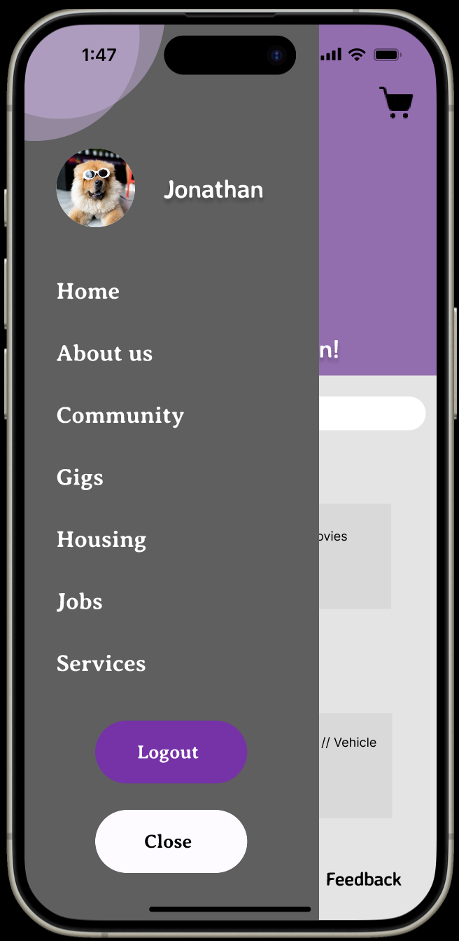
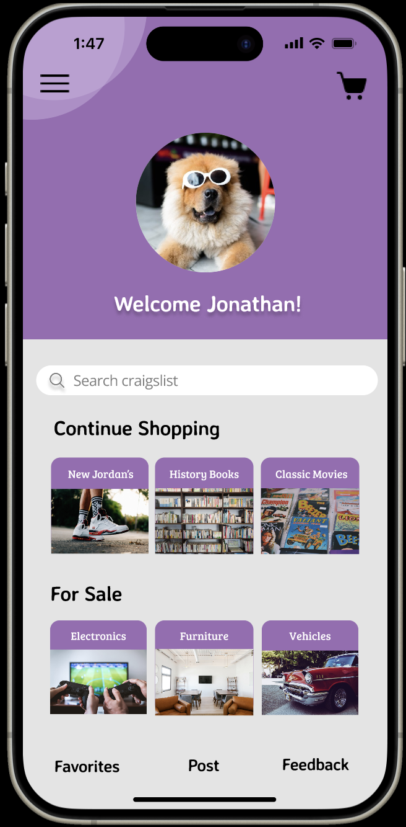

Slide 13
Figma Final Wireframe - Craigslist Mobile Redesign
Thank you for listening!

